Slide 1

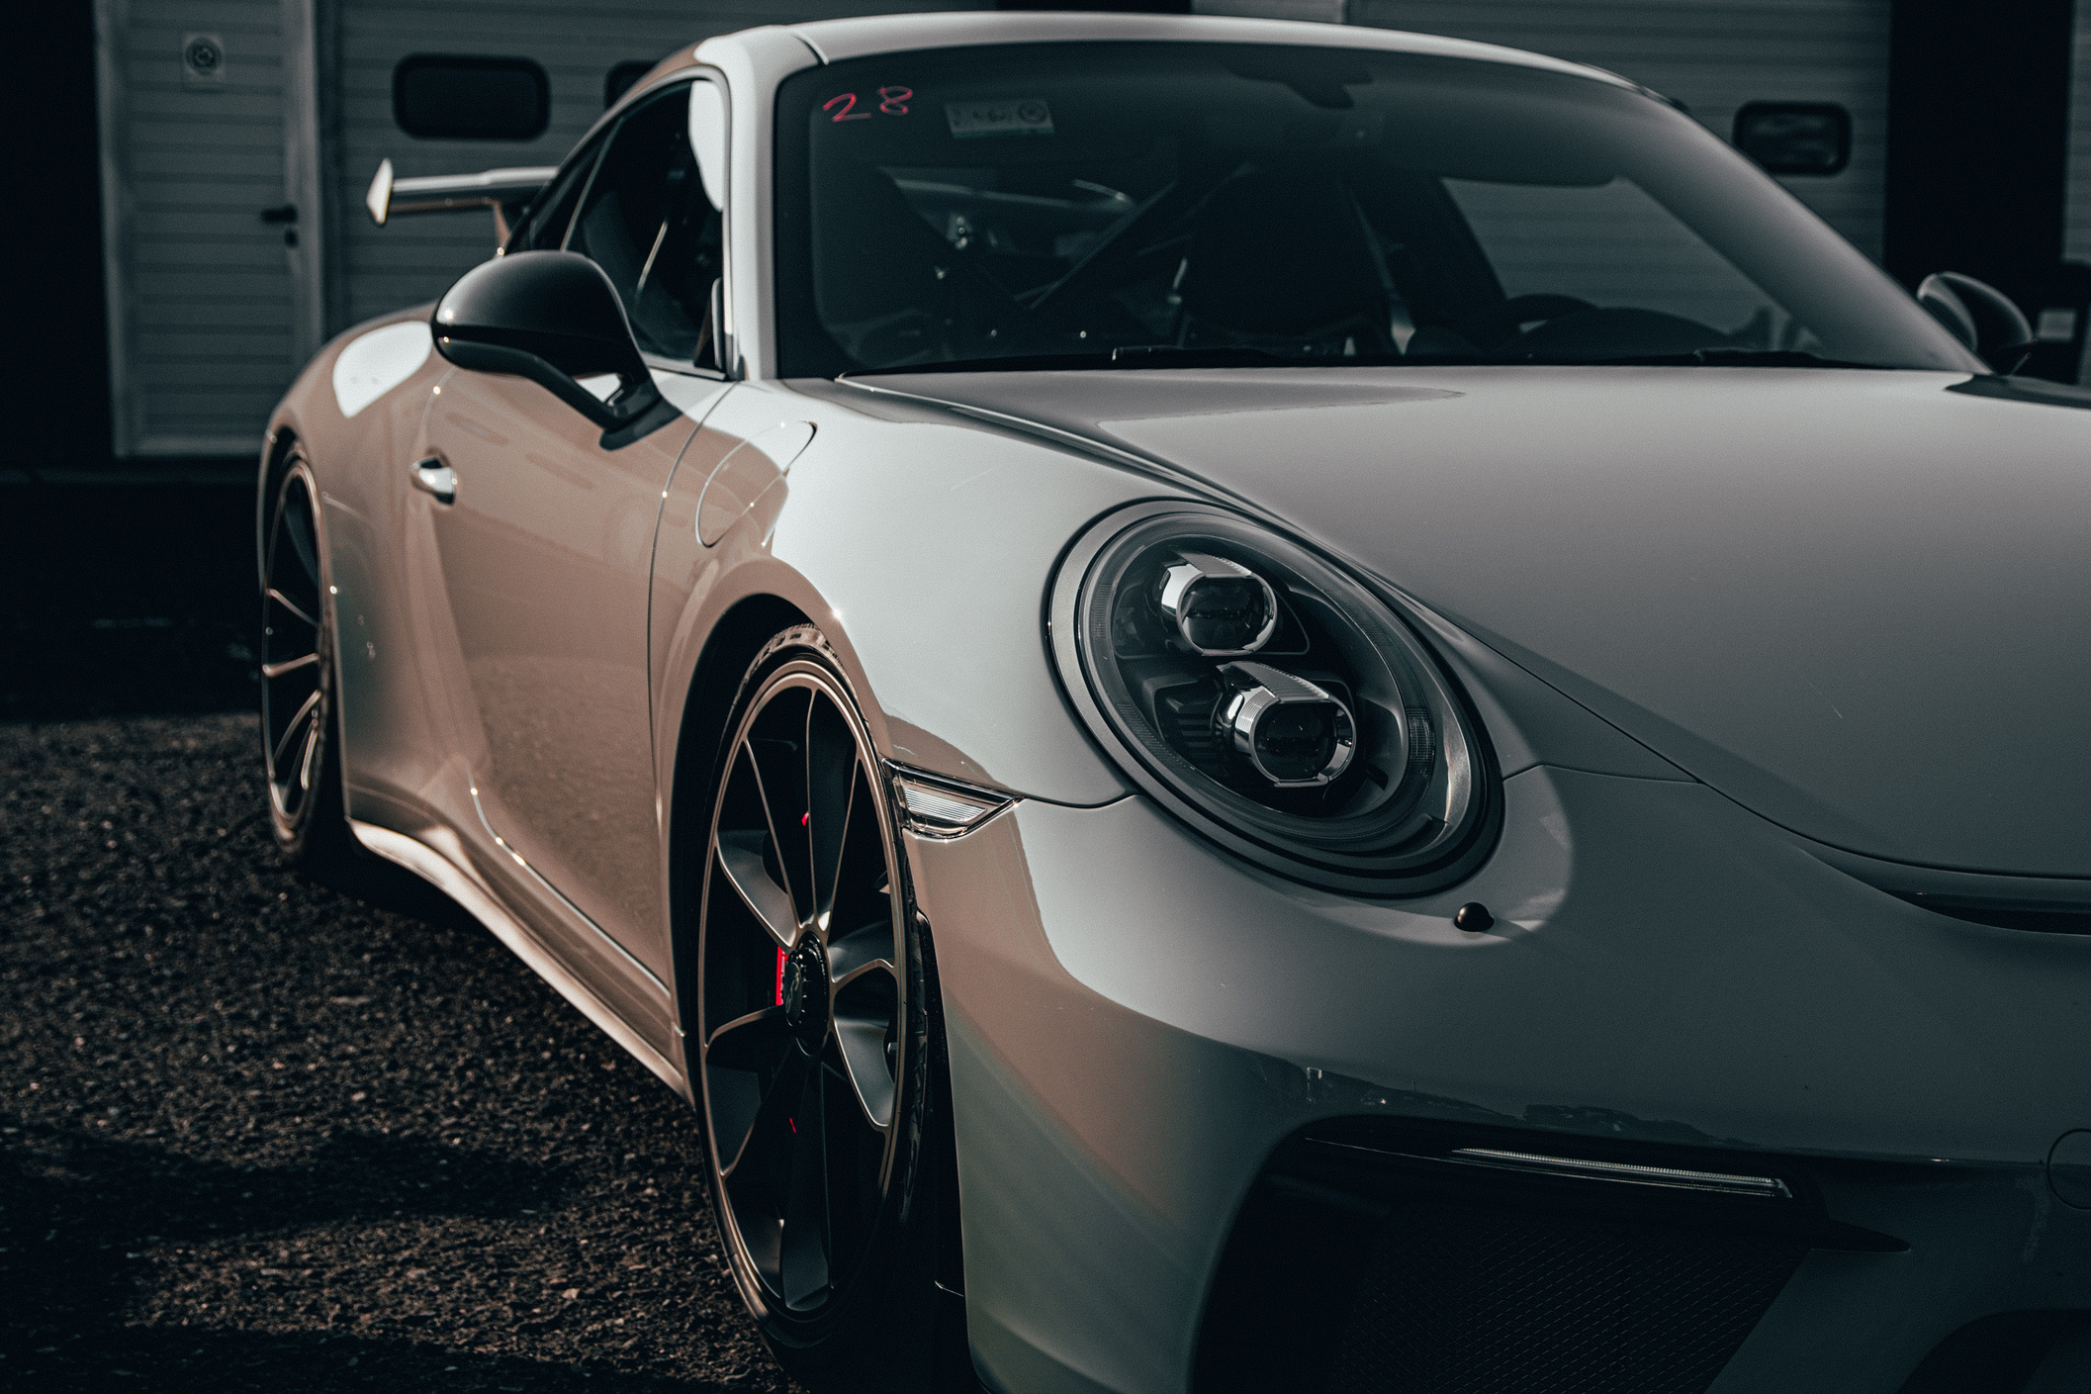


THE FUTURE
OF VEHICLES
INNOVATION, AUTOMATION & SUSTAINABILITY
Neelanga Sooriyaarachchi
28.05.2025

Slide 2
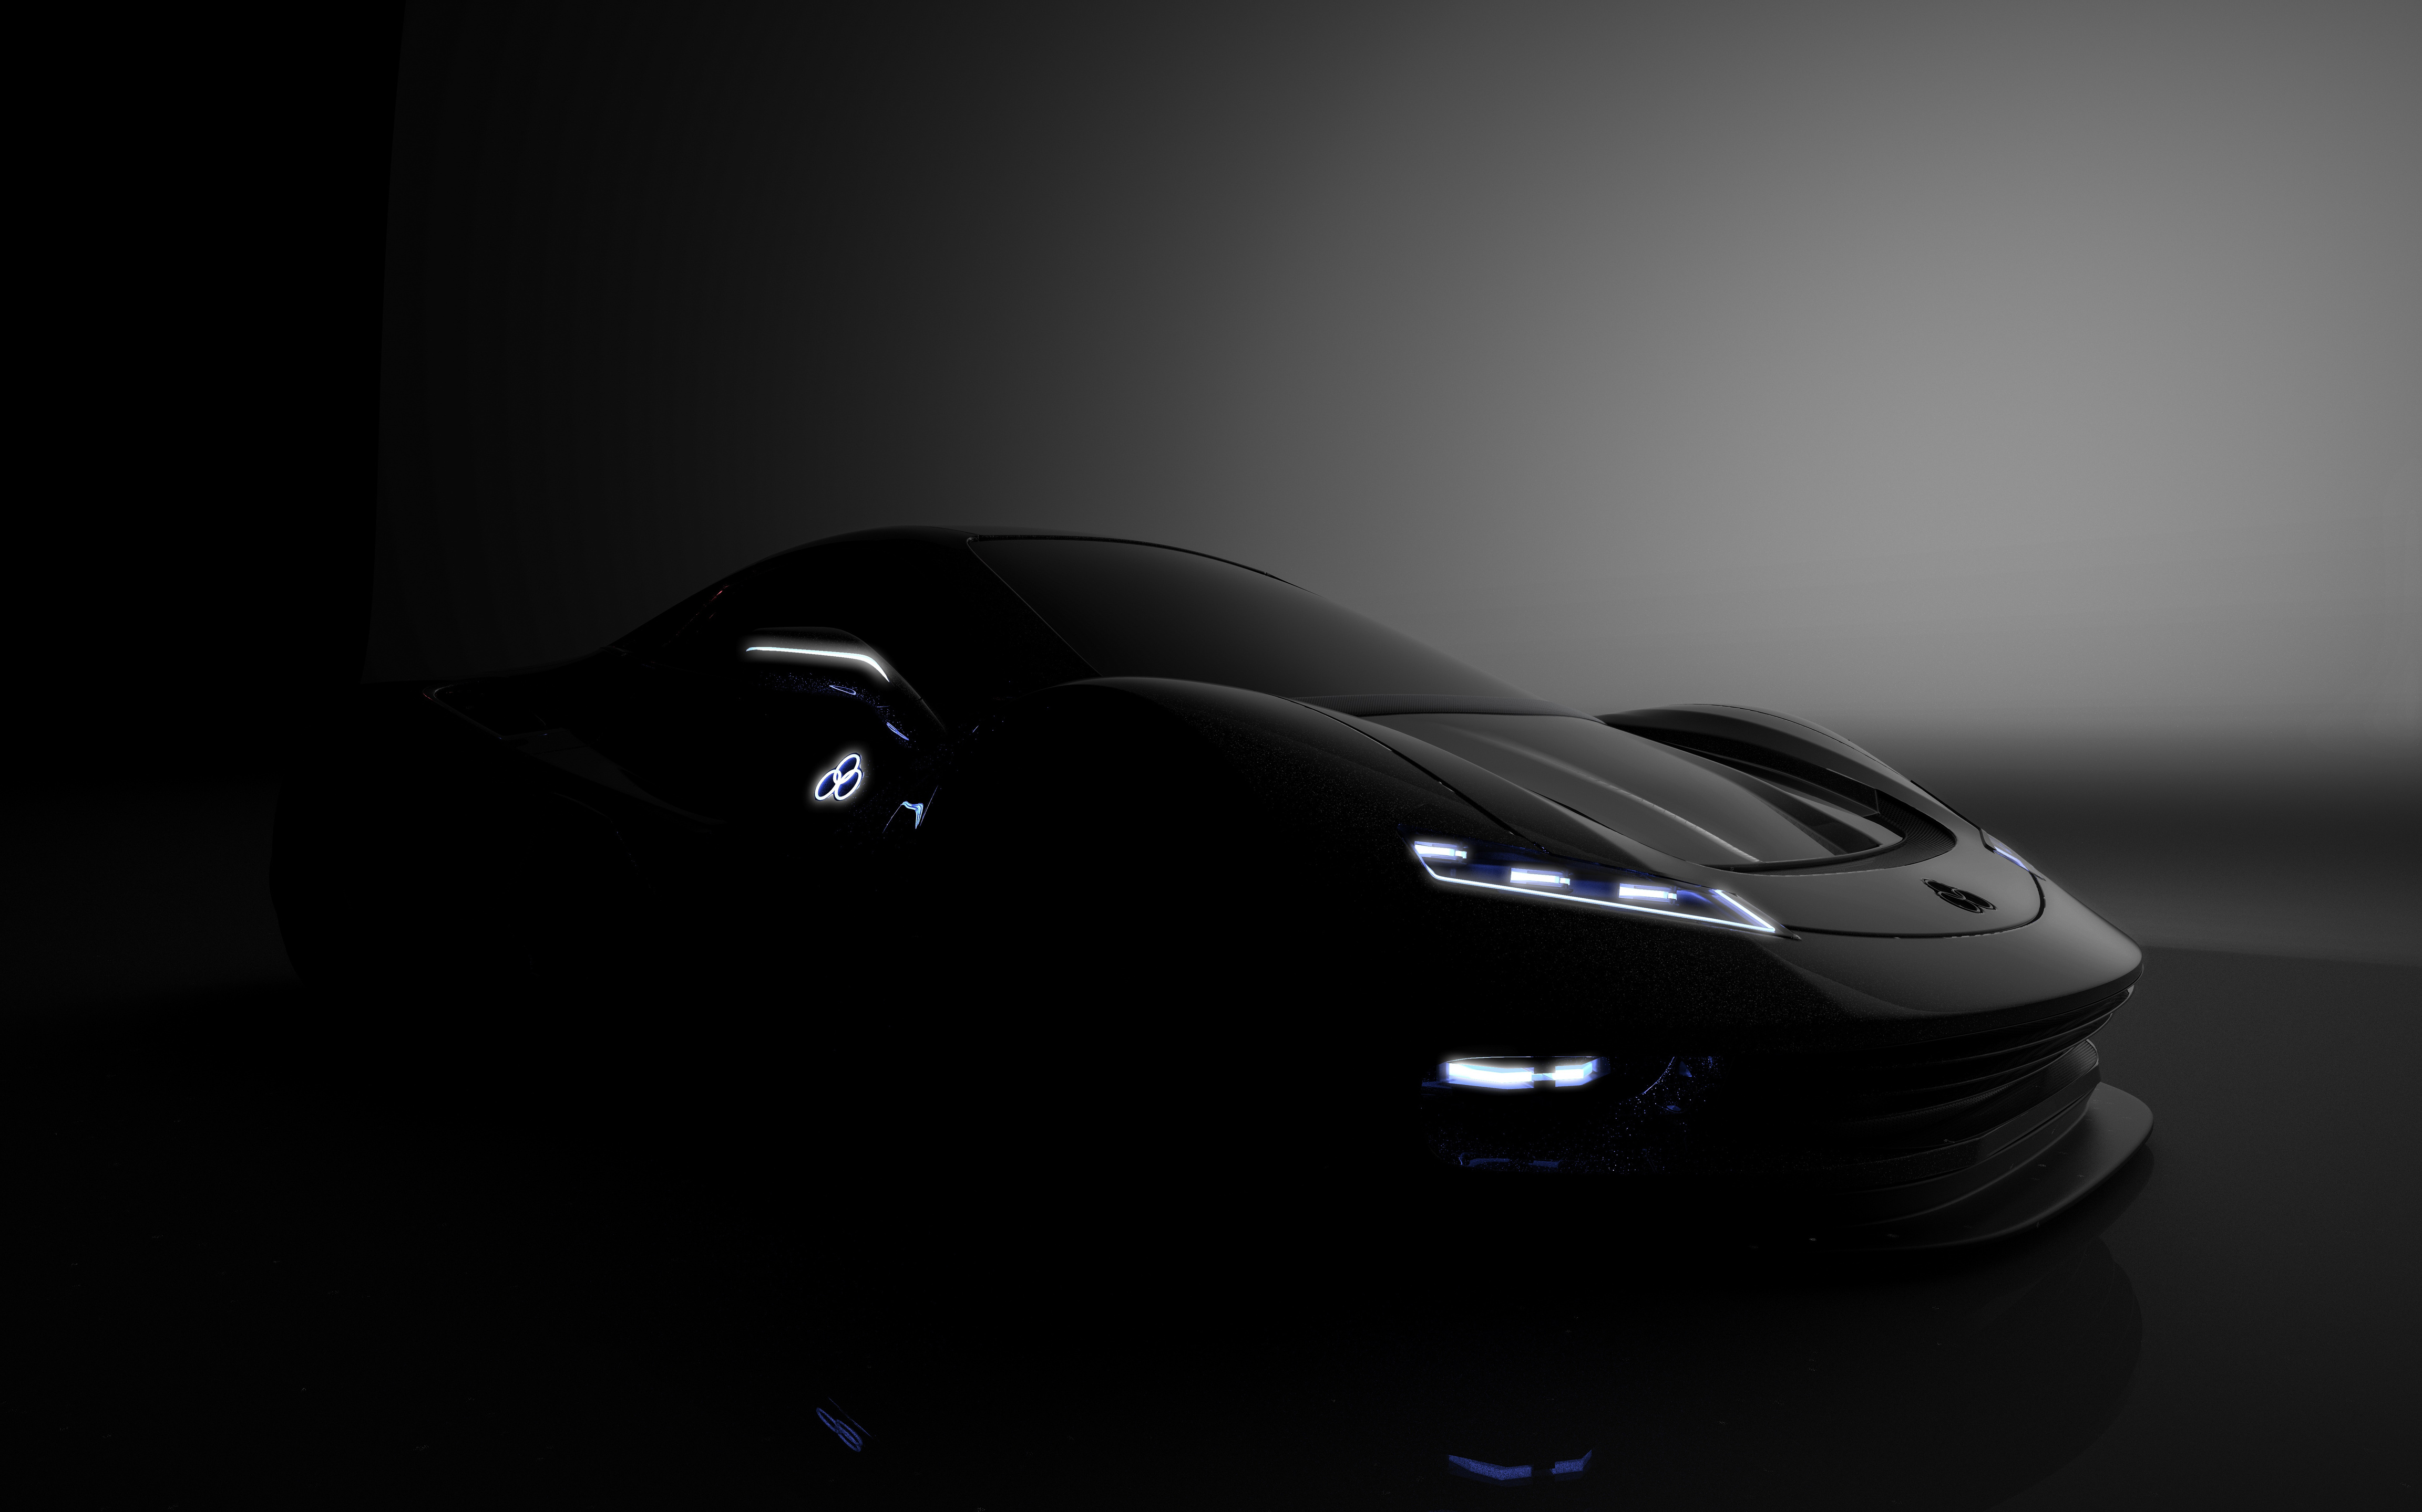
DRIVING INTO THE FUTURE
Rapid advancements in automotive technology.
Key trends shaping the future of vehicles.
Global focus on sustainability and smart mobility.

Slide 3
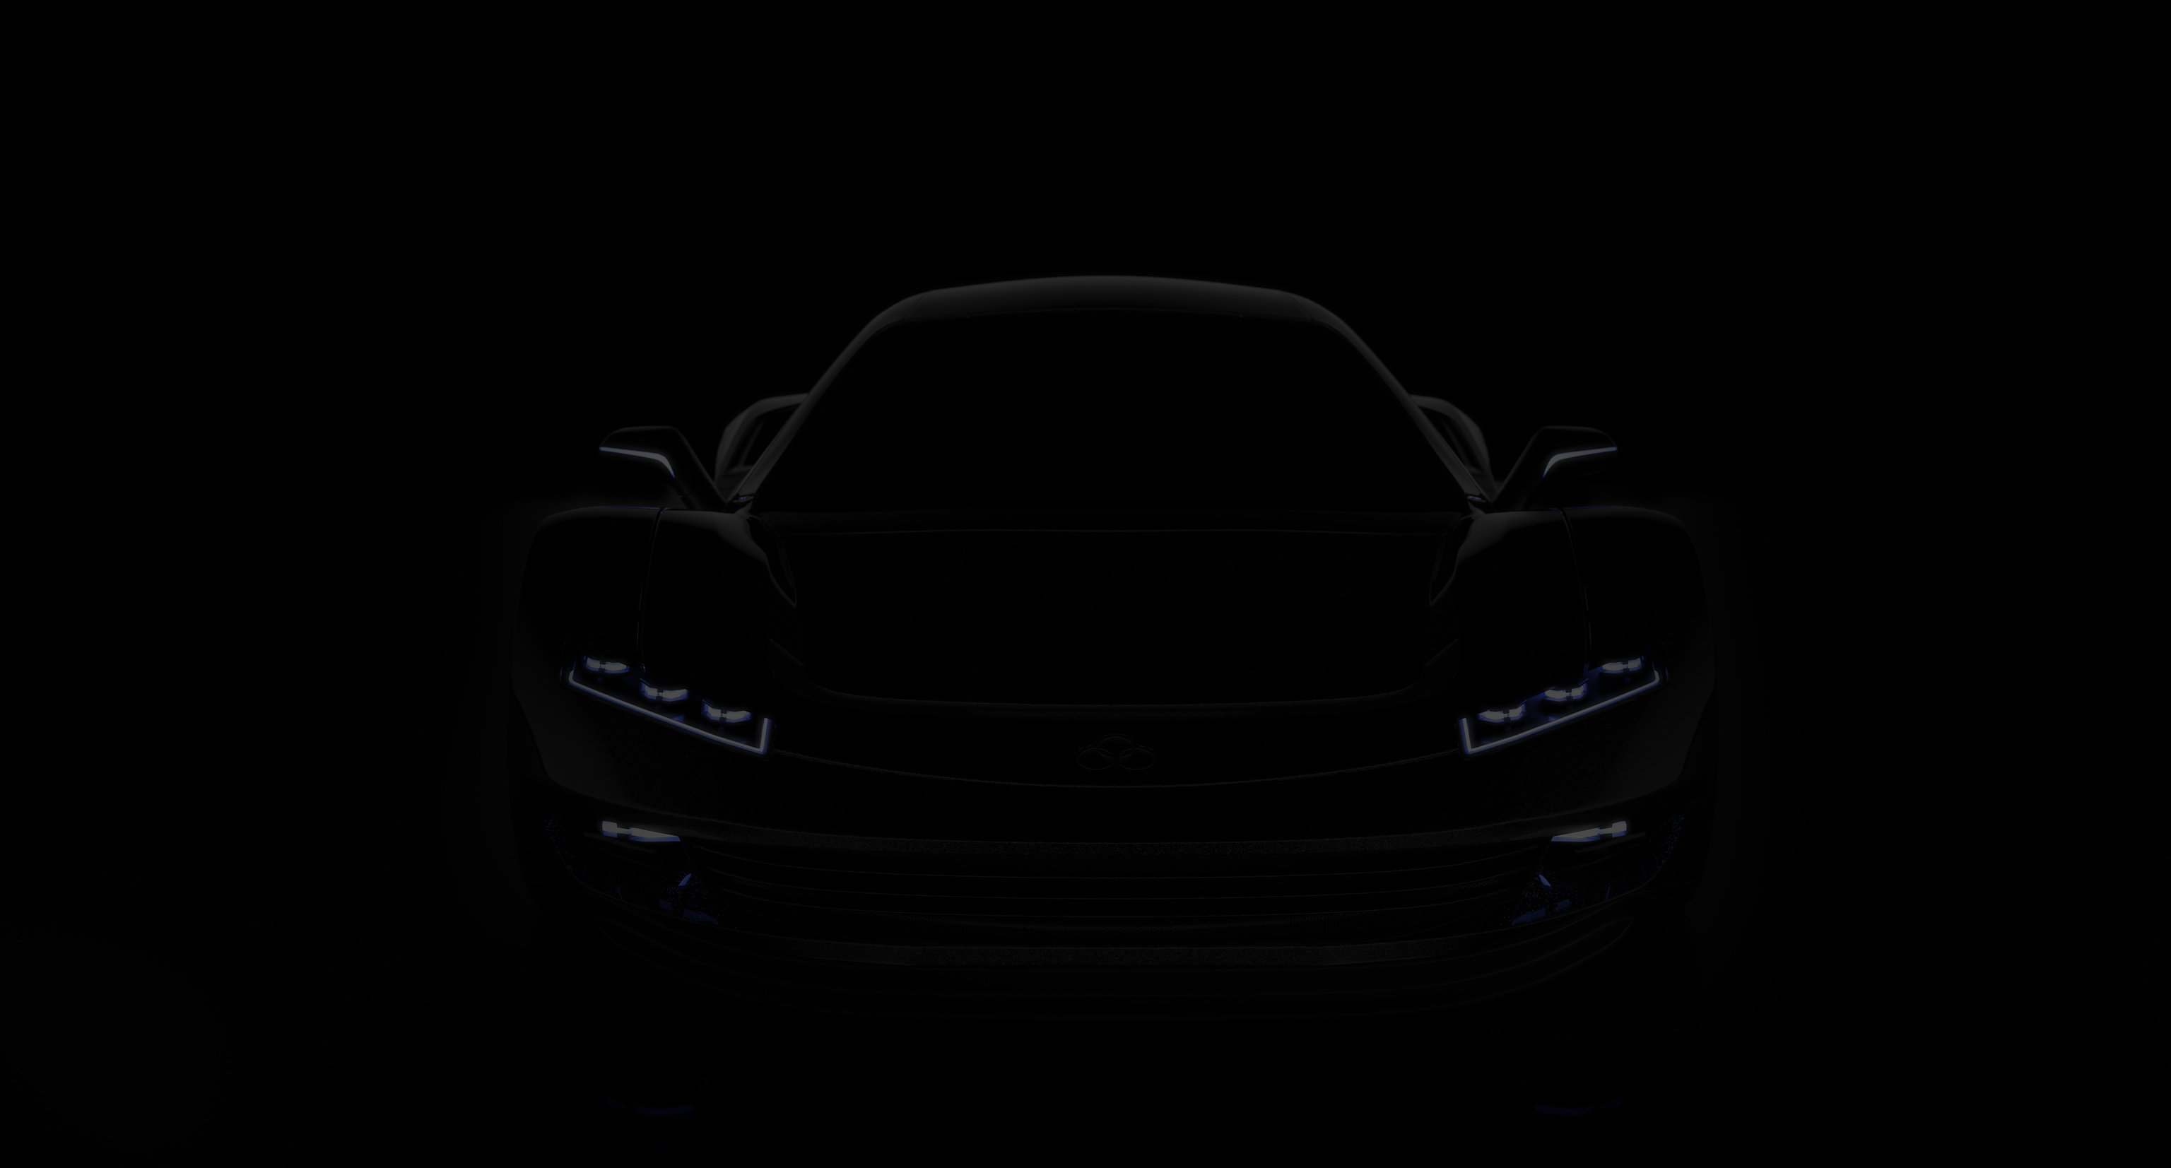

ELECTRIFICATION OF VEHICLES
RISE OF ELECTRIC VEHICLES (EVS)
Transition from internal combustion engines (ICE) to EVs
Environmental and economic benefits
Growth in EV adoption worldwide

Slide 4
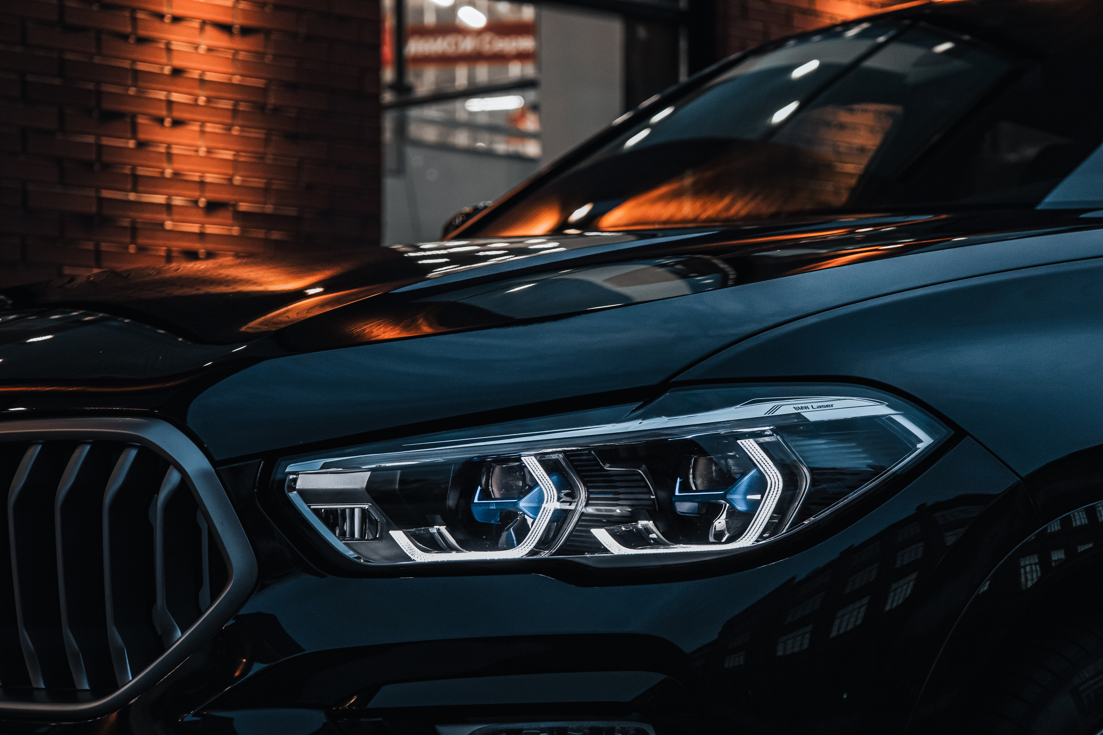
AUTONOMOUS DRIVING
SELF-DRIVING TECHNOLOGY
Levels of vehicle autonomy (Level 0–5)
Companies leading autonomous tech (e.g. Tesla, Waymo)
Benefits: safety, efficiency, convenience

Slide 5

CONNECTED VEHICLES
THE INTERNET OF CARS
Vehicle-to-Everything (V2X) communication.
Real-time data sharing: traffic, weather, hazards.
Integration with smart cities and IoT.

Slide 6
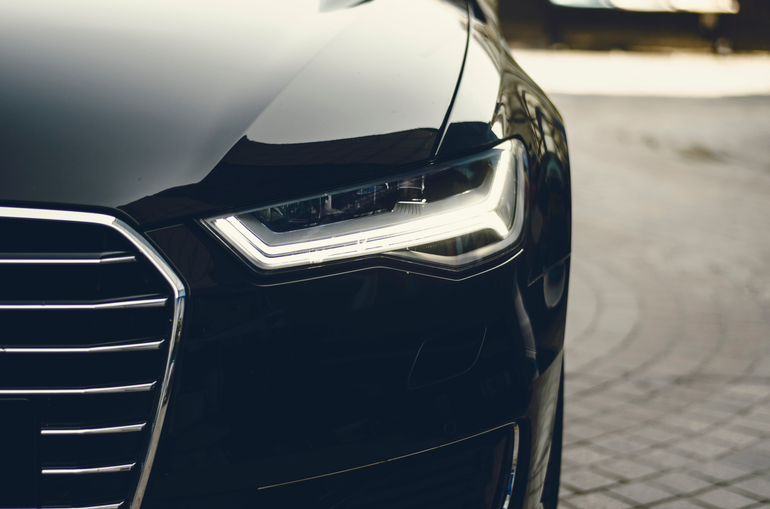
SHARED MOBILITY
FROM OWNERSHIP TO ACCESS
Growth of ride-sharing and car-sharing platforms.
Reduction in vehicle ownership.
Cost-effective and eco-friendly transport solutions.

Slide 7

SUSTAINABLE MATERIALS
& DESIGN
GREEN MANUFACTURING
Use of recycled and renewable materials.
Lightweight, energy-efficient designs.
Circular economy in automotive production.

Slide 8

ALTERNATIVE FUELS
BEYOND ELECTRICITY
Hydrogen fuel cell vehicles (FCEVs).
Biofuels and synthetic fuels.
Comparing different zero-emission technologies.

Slide 9

SMART INFRASTRUCTURE
ROADS THAT THINK
Smart traffic lights and adaptive signals.
EV charging infrastructure.
Integration with 5G and AI for real-time traffic management.

Slide 10

CHALLENGES AND CONSIDERATIONS
WHAT STILL NEEDS WORK
Regulatory and ethical concerns (esp. autonomous driving).
Cybersecurity threats in connected cars.
Charging infrastructure and grid capacity.

Slide 11
VISION FOR 2035 AND BEYOND
WHAT WILL TOMORROW LOOK LIKE ?
Widespread EV and AV adoption.
Fully connected and intelligent mobility ecosystems.
Seamless integration with renewable energy.

Slide 12
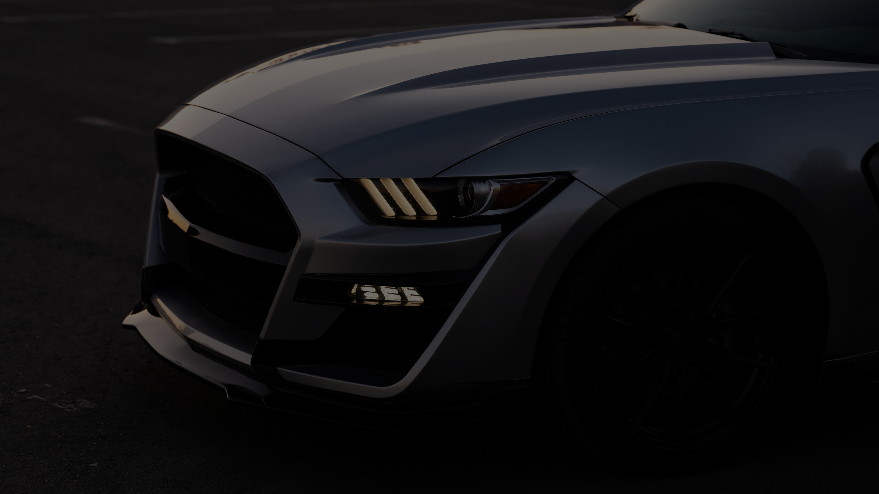
THE FUTURE IS NOW
CONCLUSION
Vehicles are evolving rapidly.
Emphasis on clean, smart, and shared mobility.
A future defined by innovation and sustainability.

